Slide 1
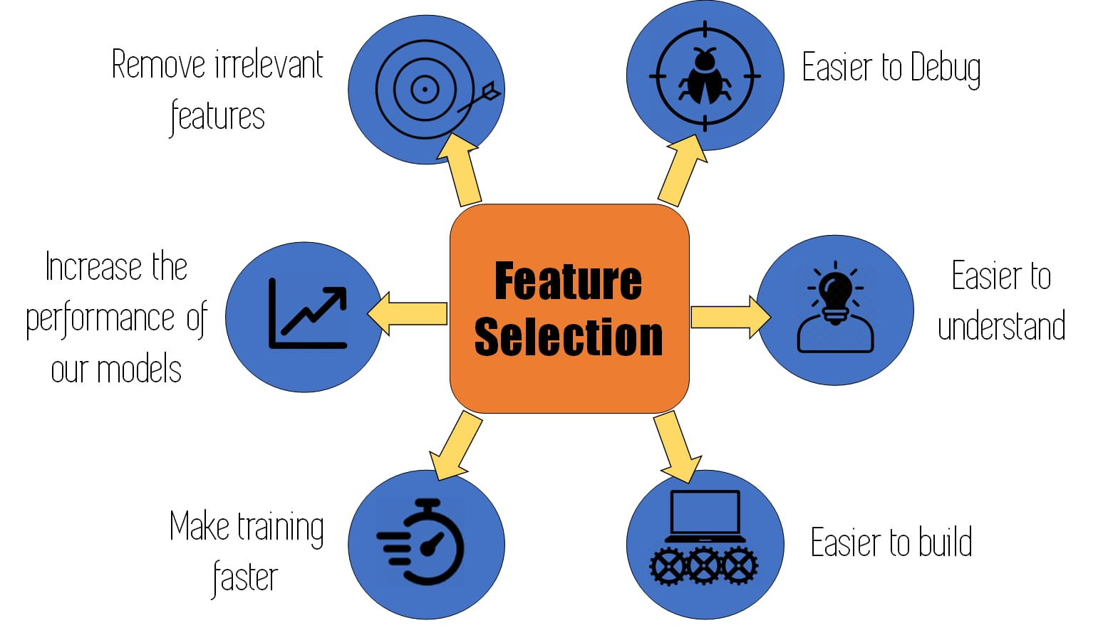
Feature Selection
Feature selection is the process of reducing the number of input variables when developing a predictive model.
It’s select the most significant features from a dataset.In many cases,feature selection can enhance the performance of a machine learning model as well.

Slide 2
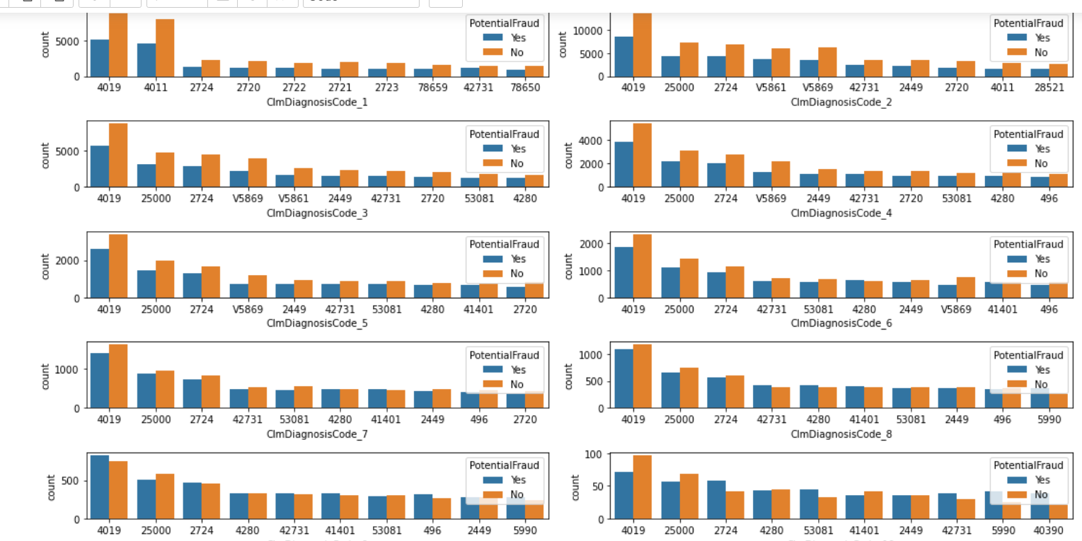
Key features selected are
The key features include beneficiary ID, claim procedure ID ,physicians involved and claim diagnosis and the below plots prove them.
In below plot, we can say that diagnosis 4019,25000 are top diagnosis codes involved in fraudulent claims.

Slide 3
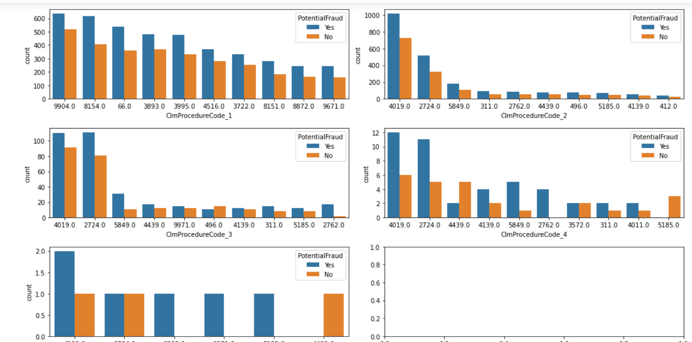
Claim procedure code
In below plot, we can say that Procedure 9904,4019 and 4139 are top procedures involved in these fraudulent claims

Slide 4
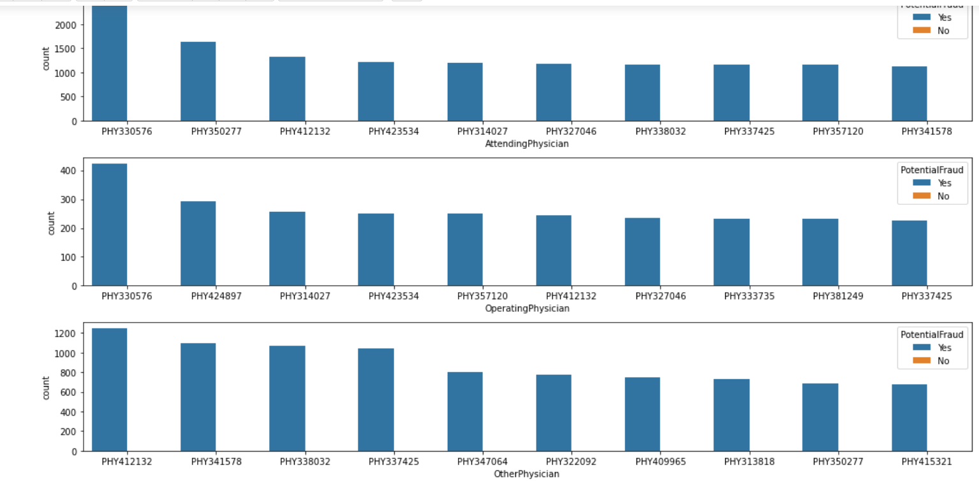
Physicians id
From the plot it can be found that these physicians are only involved in fraudulent claims which proves it to be a significant feature in model building.
Attending physician is more involved in fraudulent claim .

